Slide 1
ONLINE ATTENDANCE MANAGEMENT SYSTEM
AP- WEB/CC/AI TRACK CAPSTONE PROJECT
Presented By:
1. Miss Kamarthi Ramani – RGUKT,R K Valley
Guided By:P.Raghavan

Slide 2
OUTLINE
Abstract
Problem Statement (Should not include solution)
Aims , Objective & Proposed System/Solution
System Design
System Development Approach(Technology Used)
Algorithm & Deployment
Conclusion
References
Future Scope

Slide 3
Abstract
Student attendance management system deals with the maintenance of the
student’s attendance details. It is generates the attendance of the student on
basis of presence in class. It is maintained on the daily basis of their
attendance. the staffs will be provided with the separate username &
password to make the student’s status. The staffs handling the particular
subjects responsible to make the attendance for all students. Only if the
student present on that particular period, the attendance will be calculated.
The students attendance reports based on weekly and consolidate will be
generated.

Slide 4
Problem Statement
Click to add TIn this technical era information plays vital role in any once life.
Likewise for a University sharing of the features, placements, faculty,
student’s achievements, location etc. are important and this can be achieved
easily by maintaining a website because it will be available throughout the
globe and updating of the website lets include the new features and new
data so that everyone can see the same.
This website enhances the popularity of the college within less time as
it is available over the internet because many of them now a day’s most of
the people first prefer to check details and visit later on.
The system allows admin to updates the events quickly in online notice
board and those are reflected on user side so user can get updates .

Slide 5
Proposed Solution
“Attendance Management System” is software developed for maintaining the
attendance of the student on the daily basis in the collage. Here the staffs,
who are handling the subjects, will be responsible to mark the attendance of
the students. Each staff will be given with a separate username and
password based on the subject they handle. An accurate report based on the
student attendance is generated here. This system will also help in
evaluating attendance eligibility criteria of a student. Report of the student’s
attendance on weekly and monthly basis is generated.

Slide 6
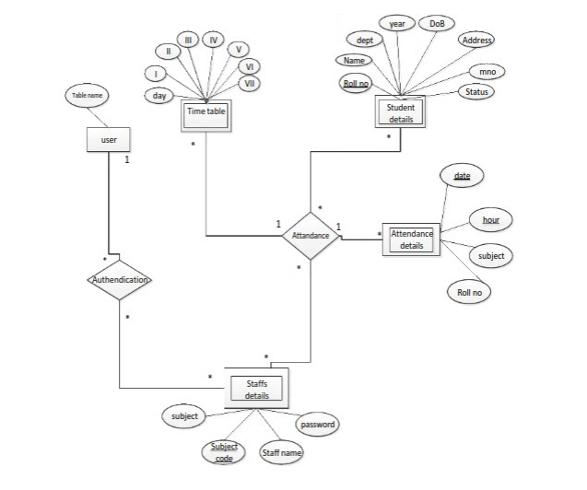
System Architecture

Slide 7
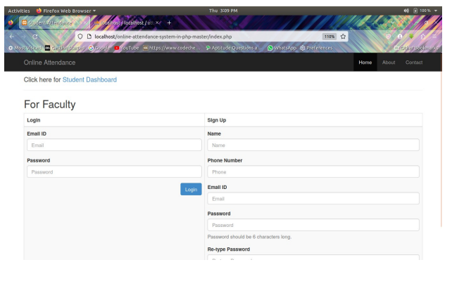
System Deployment Approach

Slide 8
Algorithm & Deployment

Slide 9
THANK YOU

